Slide 1
EE359 – Lecture 6 Outline
Review of Last Lecture
Signal Envelope Distributions
Average Fade Duration
Wideband Multipath Channels
Scattering Function

Slide 2
Review of Last Lecture
For a narrowband fading model (T_{m}<<1/B), received signal has a random, complex amplitude gain
Under CLT approximation, in-phase and quadrature signal components of received signal are Gaussian processes
  For φ_{n}~U[0,2π], the processes are zero mean, WSS, with
Correlation under Uniform AOAs
  Autocorrelation goes as J₀(2πf_{D}τ), zero cross correlation
=0

Slide 3
Signal Envelope Distribution
CLT approx. leads to Rayleigh distribution (power is exponential)
When LOS component present, Ricean distribution is used
Measurements support Nakagami distribution in some environments
  Similar to Ricean, but models “worse than Rayleigh”
  Lends itself better to closed form BER expressions

Slide 4
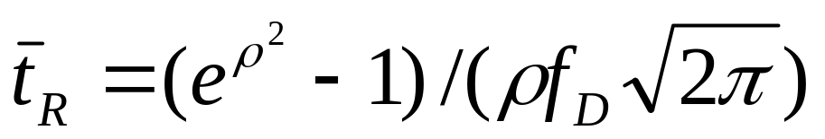
Average Fade Duration
How long a signal stays below target R (SNR γ)
Derived from level crossing rate of fading process
For Rayleigh fading
  Depends on ratio of target to average level (ρ)
  Inversely proportional to Doppler frequency
t₁
t₂
t₃
R

Slide 5




Wideband Channels
Individual multipath components resolvable
True when time difference between components exceeds signal bandwidth
τ
τ
Narrowband
Wideband

Slide 6
Scattering Function
Fourier transform of c(τ,t) relative to t
Typically characterize its statistics, since c(τ,t) is different in different environments
Since underlying process Gaussian, need only characterize mean (0) and correlation
Autocorrelation is A_{c}(τ₁,τ₂,Δt)=A_{c}(τ,Δt)
Statistical scattering function:
s(τ,ρ)=F_{Δt}[A_{c}(τ,Δt)]
ρ
τ

Slide 7
Main Points
Narrowband fading distribution depends on environment
  Rayleigh, Ricean, and Nakagami all common
Average fade duration determines how long a user is in continuous outage (e.g. for coding design)
Wideband models characterized by scattering function: measures power vs delay and doppler
Scattering function used to characterize channel rms delay and Doppler spread. Key parameters for system design.

